Slide 1


Query Millions of WGS Variants in Minutes with Azure Synapse

Slide 2
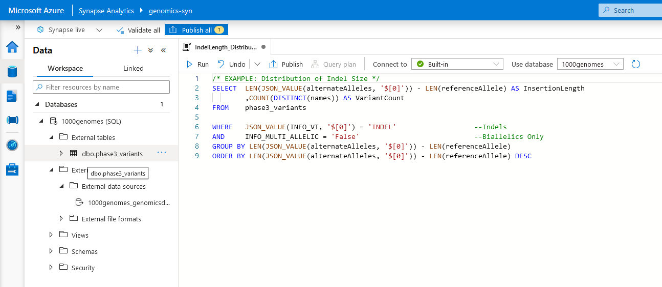
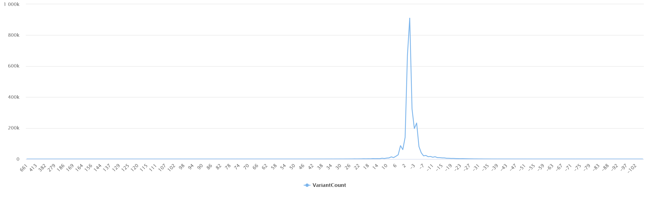
What’s Azure Synapse?
“Limitless analytics service with unmatched time to insight.”
Scalable analytics platform that includes a SQL engine (formerly Azure SQL Data Warehouse), Data Lake exploration, Apache Spark, integration with Power BI, and more.

Slide 3
Quick Data Stats
Population
Yoruba
Luhya
Dai Chinese
CEPH
Japanese
Han Chinese
Gujarati
Tamil
Telugu
British
African Caribbean
Puerto Rican
Southern Han Chinese
Finnish
Kinh Vietnamese
Bengali
African Ancestry SW
Colombian
Peruvian
Punjabi
Mende
Esan
Gambian Mandinka
Iberian
Toscani
Mexican Ancestry
1000 Genomes Project
VCF File Size: ~168GB
80+ Million Variants
2,504 Individuals
Phase 3
(GRCh38)
Parquet File Size: ~75GB
Sudmant, P., Rausch, T., Gardner, E. et al. An integrated map of structural variation in 2,504 human genomes. Nature 526, 75–81 (2015). https://doi.org/10.1038/nature15394

Slide 4


Pipeline
Read in VCFs from
Data Lake in Apache Spark with Glow
Calculate Summary Statistics using Glow
Write out Data
to Data Lake
as Parquet Files
Create External Table
of All Variants in
Azure Synapse

Slide 5
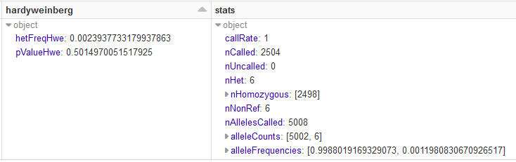
Converting VCFs to Parquet Files
(in 4 lines of code)
input_vcf_path = "/mnt/1000genomes/phase3_vcfs/chr1.vcf.gz"
output_parquet_path = "/mnt/1000genomes/phase3_parquets/chr1.parquet"
vcf_df = spark.read.format("vcf").load(input_vcf_path) \
.withColumn("hardyweinberg", expr("hardy_weinberg(genotypes)")) \
.withColumn("stats", expr("call_summary_stats(genotypes)"))
vcf_df.write.format("parquet").save(output_parquet_path)
+ 2 lines for adding some stats…

Slide 6
Converting VCFs to Parquet Files
(in 4 lines of code)
input_vcf_path = "/mnt/1000genomes/phase3_vcfs/chr1.vcf.gz"
output_parquet_path = "/mnt/1000genomes/phase3_parquets/chr1.parquet"
vcf_df = spark.read.format("vcf").load(input_vcf_path) \
vcf_df.write.format("parquet").save(output_parquet_path)

Slide 7
Converting VCFs to Parquet Files
(in 4 lines of code)
input_vcf_path = "/mnt/1000genomes/phase3_vcfs/chr1.vcf.gz"
output_parquet_path = "/mnt/1000genomes/phase3_parquets/chr1.parquet"
vcf_df = spark.read.format("vcf").load(input_vcf_path) \
.withColumn("hardyweinberg", expr("hardy_weinberg(genotypes)")) \
.withColumn("stats", expr("call_summary_stats(genotypes)"))
vcf_df.write.format("parquet").save(output_parquet_path)
+ 2 lines for adding some stats…

Slide 8
Converting VCFs to Parquet Files
(in 4 lines of code)
input_vcf_path = "/mnt/1000genomes/phase3_vcfs/chr1.vcf.gz"
output_parquet_path = "/mnt/1000genomes/phase3_parquets/chr1.parquet"
vcf_df = spark.read.format("vcf").load(input_vcf_path) \
.withColumn("hardyweinberg", expr("hardy_weinberg(genotypes)")) \
.withColumn("stats", expr("call_summary_stats(genotypes)"))
vcf_df.write.format("parquet").save(output_parquet_path)
+ 2 lines for adding some stats…

Slide 9
Converting VCFs to Parquet Files
(in 4 lines of code)
input_vcf_path = "/mnt/1000genomes/phase3_vcfs/chr1.vcf.gz"
output_parquet_path = "/mnt/1000genomes/phase3_parquets/chr1.parquet"
vcf_df = spark.read.format("vcf").load(input_vcf_path) \
.withColumn("hardyweinberg", expr("hardy_weinberg(genotypes)")) \
.withColumn("stats", expr("call_summary_stats(genotypes)"))
vcf_df.write.format("parquet").save(output_parquet_path)
+ 2 lines for adding some stats…

Slide 10
Converting VCFs to Parquet Files
(in 4 lines of code)
input_vcf_path = "/mnt/1000genomes/phase3_vcfs/chr1.vcf.gz"
output_parquet_path = "/mnt/1000genomes/phase3_parquets/chr1.parquet"
vcf_df = spark.read.format("vcf").load(input_vcf_path) \
.withColumn("hardyweinberg", expr("hardy_weinberg(genotypes)")) \
.withColumn("stats", expr("call_summary_stats(genotypes)"))
vcf_df.write.format("parquet").save(output_parquet_path)
+ 2 lines for adding some stats…

Slide 11
Converting VCFs to Parquet Files
(in 4 lines of code)
input_vcf_path = "/mnt/1000genomes/phase3_vcfs/chr1.vcf.gz"
output_parquet_path = "/mnt/1000genomes/phase3_parquets/chr1.parquet"
vcf_df = spark.read.format("vcf").load(input_vcf_path) \
.withColumn("hardyweinberg", expr("hardy_weinberg(genotypes)")) \
.withColumn("stats", expr("call_summary_stats(genotypes)"))
vcf_df.write.format("parquet").save(output_parquet_path)
+ 2 lines for adding some stats…

Slide 12
Converting VCFs to Parquet Files
(in 4 lines of code)
input_vcf_path = "/mnt/1000genomes/phase3_vcfs/chr1.vcf.gz"
output_parquet_path = "/mnt/1000genomes/phase3_parquets/chr1.parquet"
vcf_df = spark.read.format("vcf").load(input_vcf_path) \
.withColumn("hardyweinberg", expr("hardy_weinberg(genotypes)")) \
.withColumn("stats", expr("call_summary_stats(genotypes)"))
vcf_df.write.format("parquet").save(output_parquet_path)
+ 2 lines for adding some stats…

